Slide 1
Eighth Lecture

Slide 2
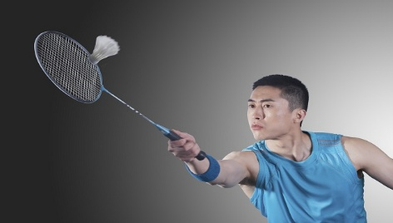
Badminton

Slide 3
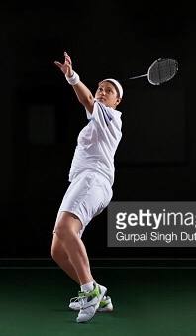
Badminton racket
Head
Hand bond
Badminton uniform
Shirt and shorts
Elbow
Knee
Foot
Shoes

Slide 4
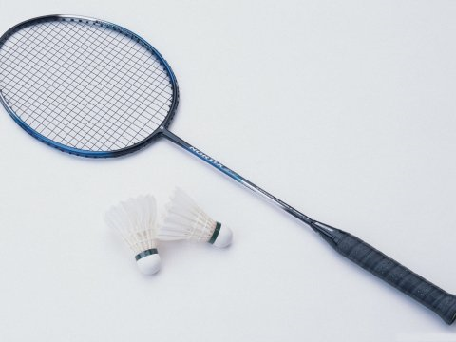
Parts of Badminton Racket
Throat
Shaft
Handle
Head
Stringed area
Shuttlecock

Slide 5
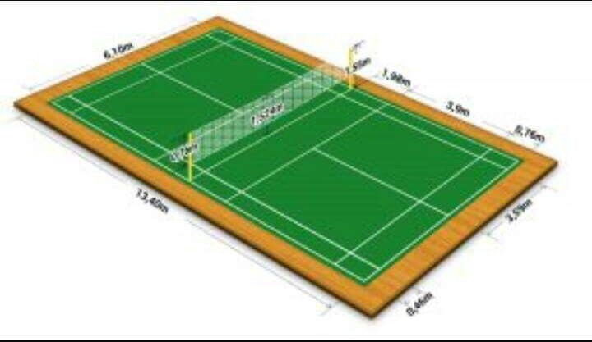
Badminton Court This picture is about badminton court .It’s long 13.40m and the width is5.18m for the single court and 6.10m for the double court .There is a net crossing the court to two halves . It's height 1.55m .

Slide 6
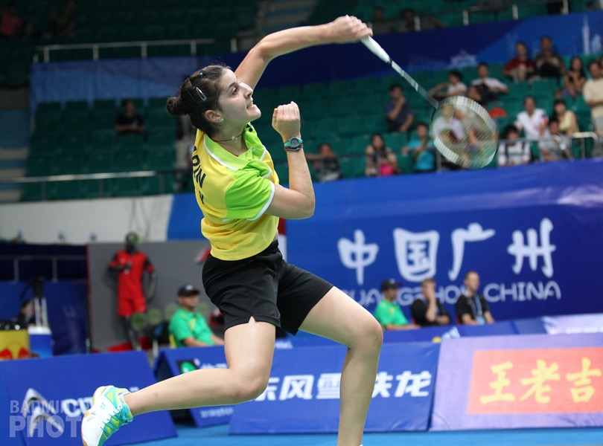
In this is picture of badminton player holding the badminton racket in her left hand and she is performing the clear backhand stroke . There is the team administrators in the back ground

