Slide 1
Second Lecture Describing Running Event

Slide 2
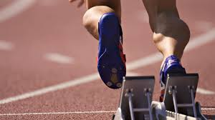
Running events

Slide 3
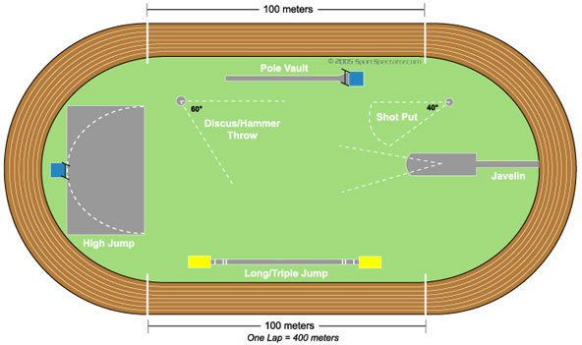
The running events
The running events include sprints, middle and long distance events, race walking, relays race and hurdling

Slide 4
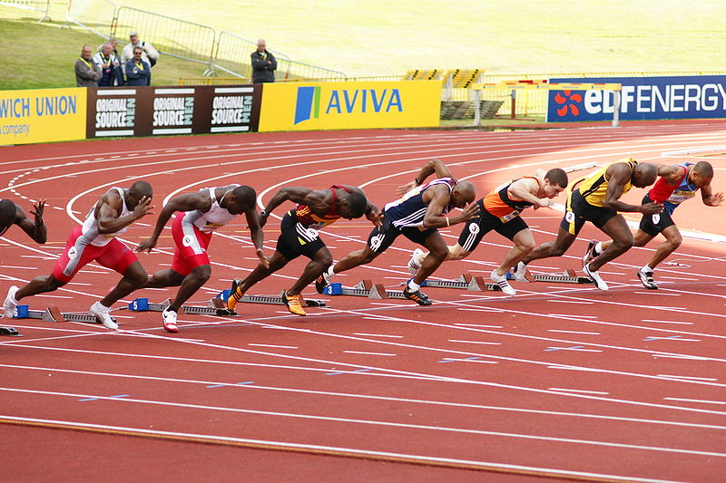
1•the sprints and middle distance
it's Include the 100m ,200m ,400m
800m and1500m

Slide 5
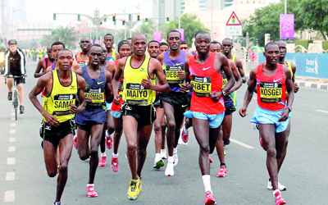
Long distance race
Long distance race is one of the running events . It is includes 3km ,3.2km, 5km and 10km run races

Slide 6
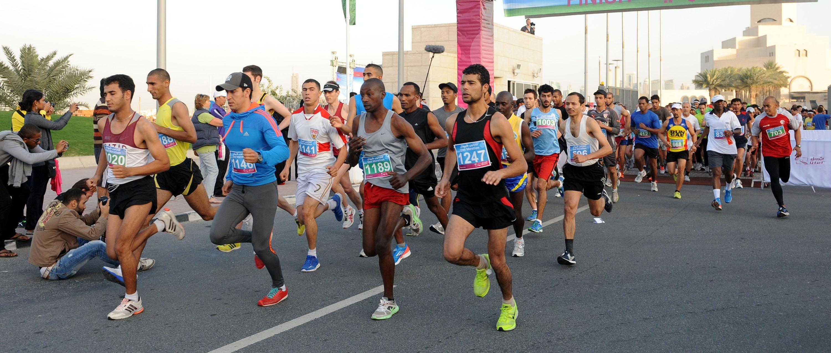
Marathon race
Marathon is long distance running race with a standard distance 42.195km . It usually done in road

Slide 7
Relays race
Relay race is one of track and field events . The athletes are running a preset distance carrying a baton before passing it to the next runner .

Slide 8
Hurdling race
Hurdle race is type of track and field races . There are sprint hurdle race and long distance hurdle race . The standard sprint hurdle race is 110m for men ,100m for women and men&women 400m hurdle race

Slide 9
Parts of body
Head
Face
Neck
Elbow
Shoulders
Chest
Hand
Stomach
Shin
Thigh
Knee
Foot
Ankle

Slide 10
Track events equipment
Vest
Libel
Spiked shoes
Start block

Slide 11
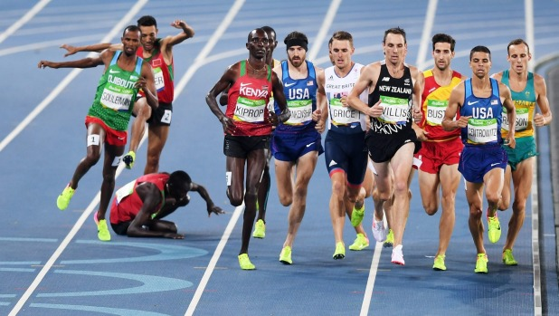
It is long distance running events. In this picture we see 11 runners ,running on the track . Eight of them are running together on their way to complete the race . The ninth player is seems that he is stumbling in his way and falling on the ground.
The other player is moving in the race despite of his stumbling with the falling runner. The last player is jumping above the falling one and continuing his way to the final line.

