Slide 1
Fourteenth Lecture

Slide 2
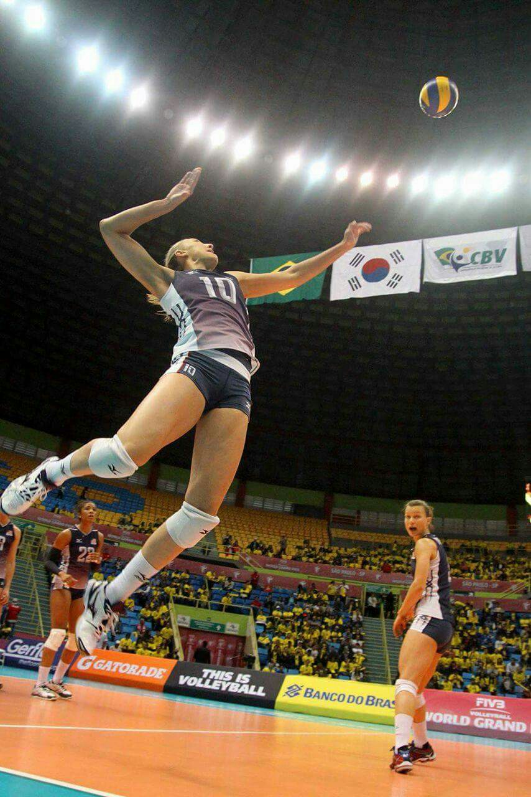

Slide 3
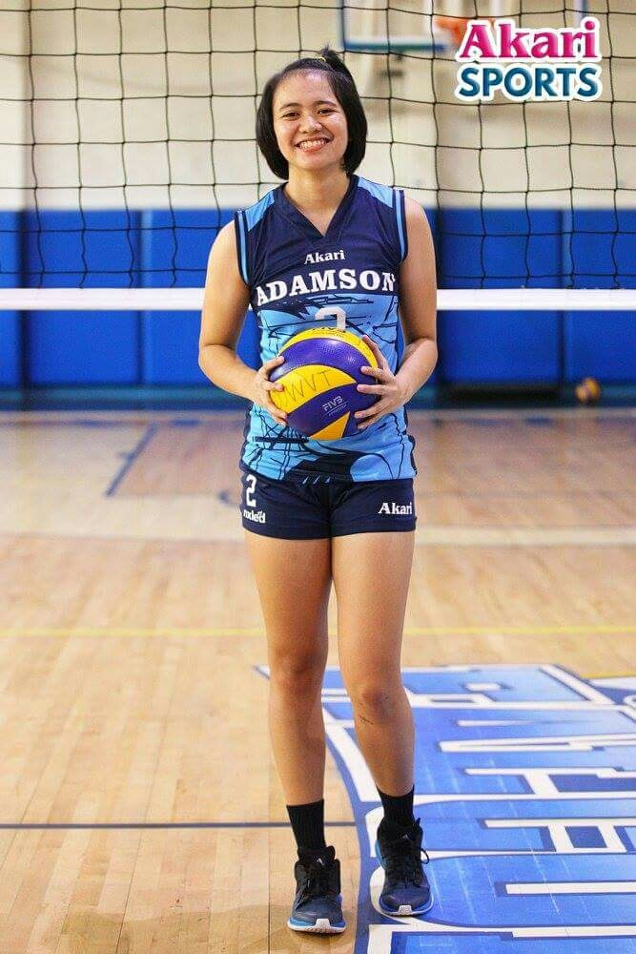
Parts of body
Equipment
head
neck
shoulder
shirt
elbow
ball
shorts
thigh
knee
socks
shin
foot
shoes

Slide 4
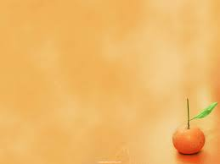
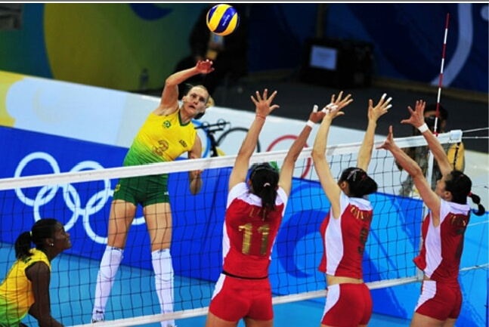
This photo is about volleyball .It seems on the court two teams of women separated by a net and shows at its side an antiena .The first team is wearing yellow and green shirts and shorts . One of the team players is trying to attack by jumping and hitting the ball with her right hand and her colleague is trying to cover the attack ing. While the second team is wearing red and white shirts and shorts . There are three players of this game are a blocking to prevent the other team from attacking

Slide 5
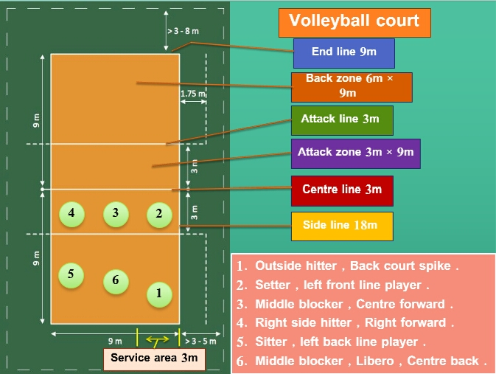
Court description

Slide 6
Net

Slide 7
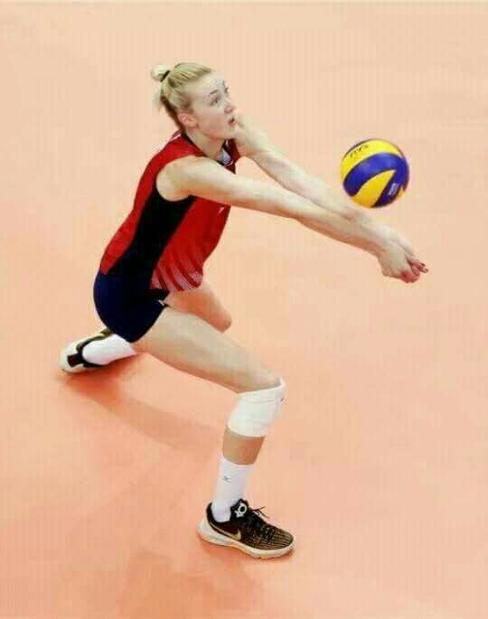
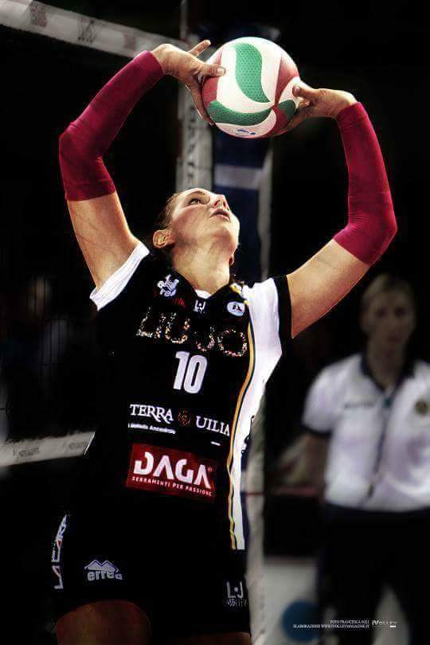
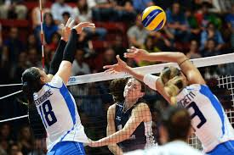
Volley ball Skills
Smash Service
Squat under the ball
smash
Blocking
Lifting the ball

Slide 8
Thank you for listening

