Slide 1
Thirteenth Lecture

Slide 2
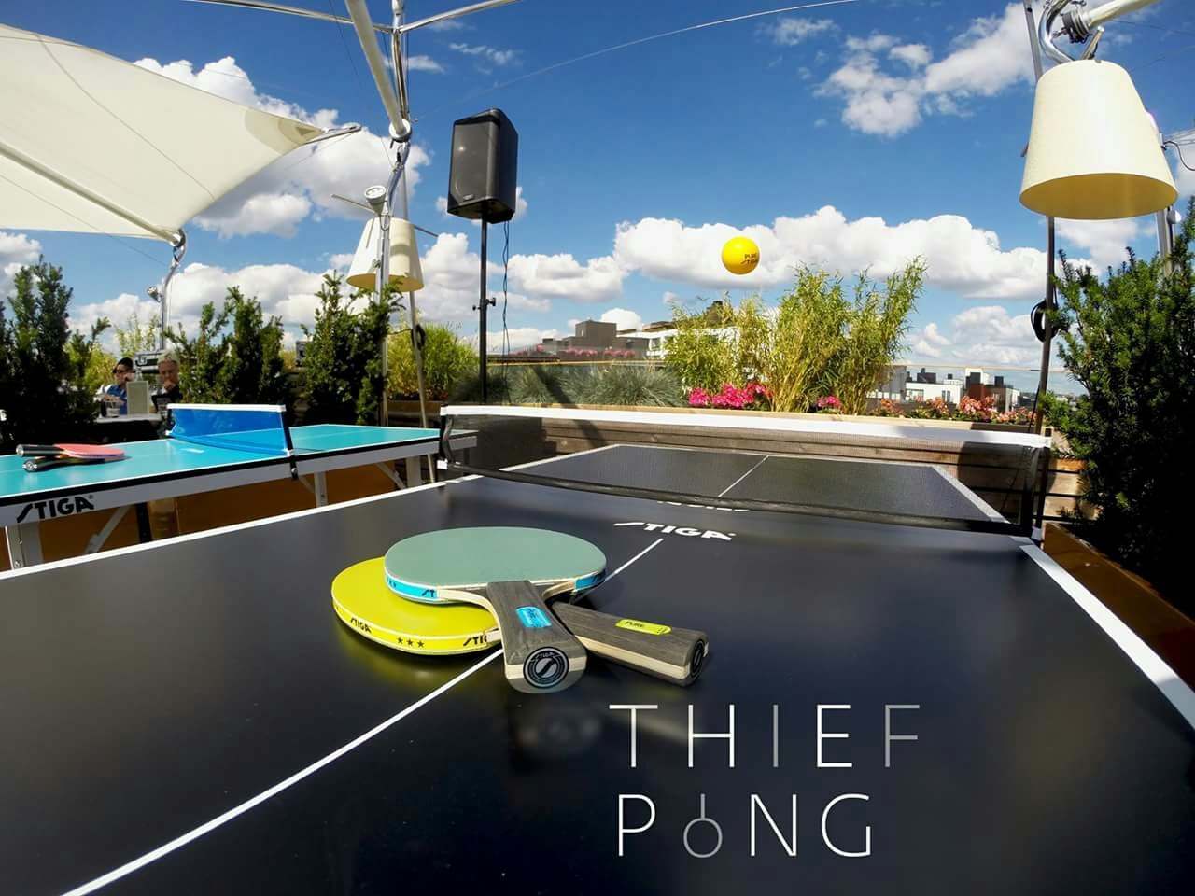
Table_tennis

Slide 3
Parts Of Body
face
hair
mouth
head
chin
neck
shoulder
arm
chest
heart
waist
elbow
belly
thigh
knee
calf
shin
ankle
foot

Slide 4
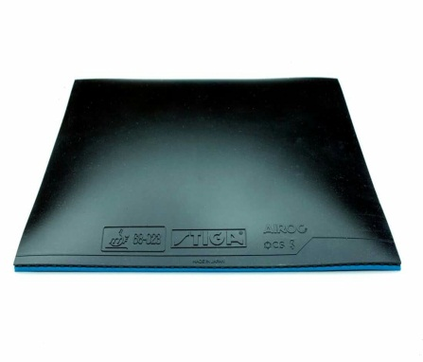
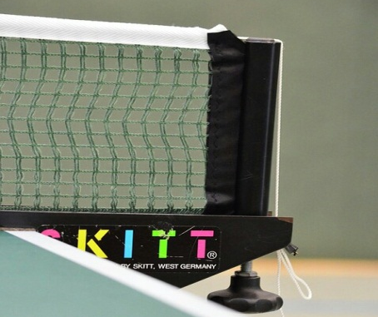
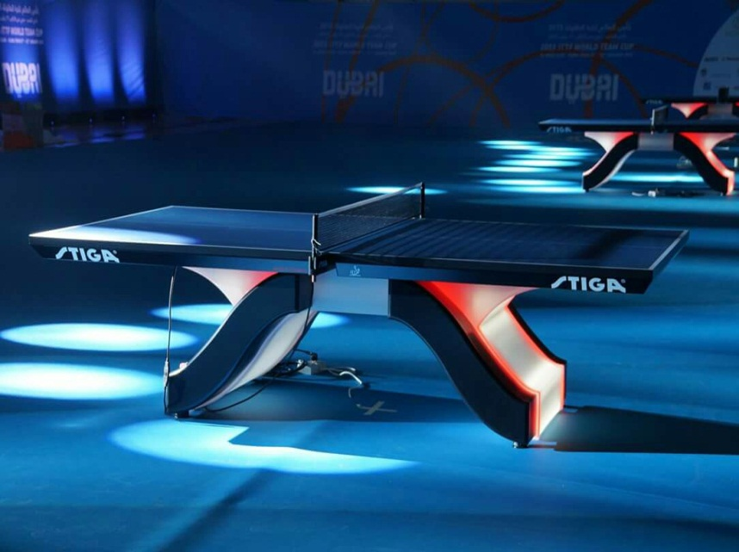
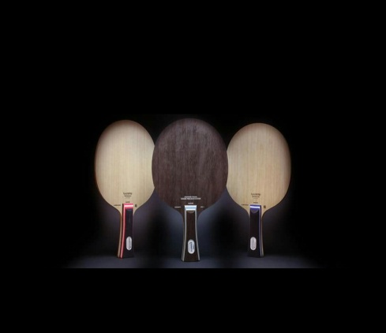
Game Equipment
Rubber
Network
Table
Tennis Racket
Ball

Slide 5
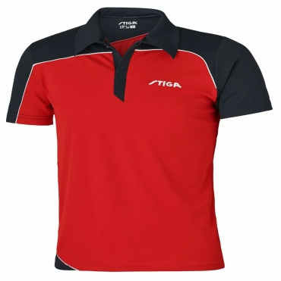
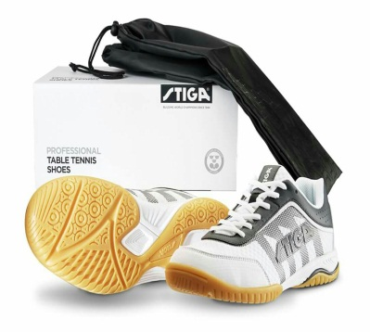
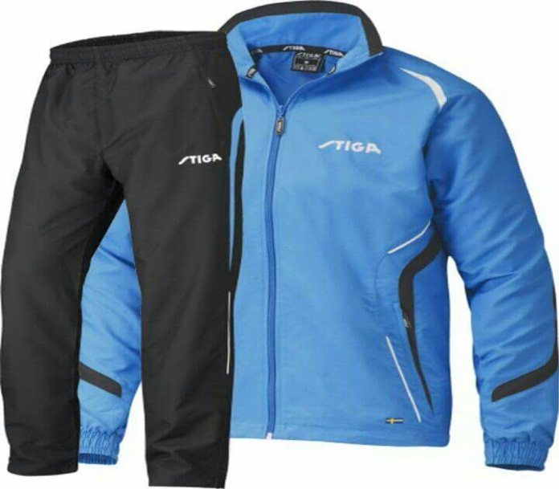
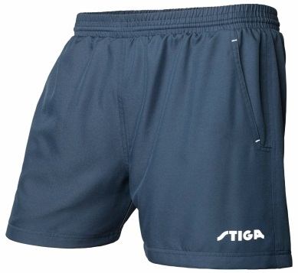
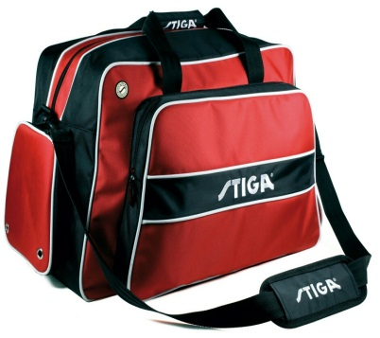
Player Equipment
Chirt
Shoe
Bag
Trac
Short

Slide 6
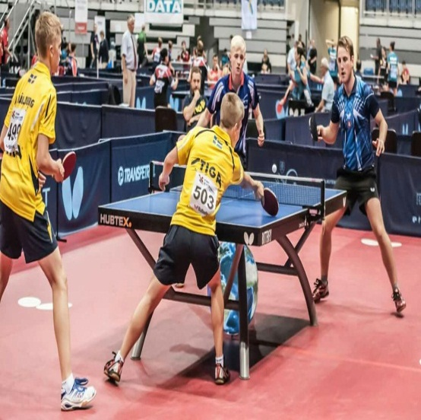
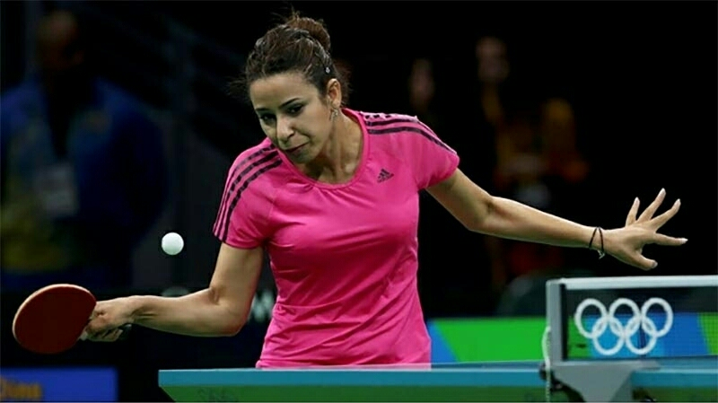
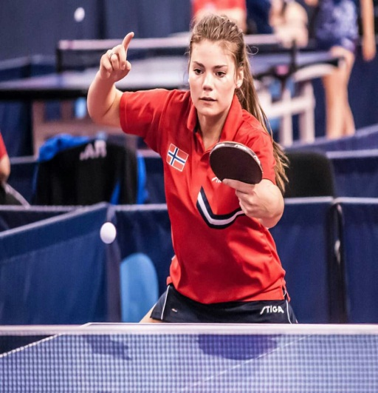
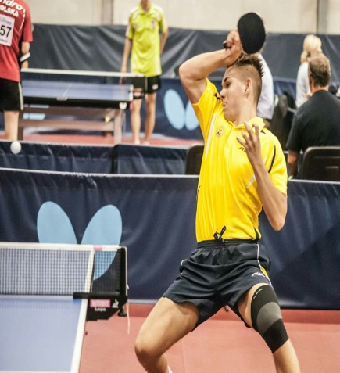
Types Of Strikes
Cut
Top Spin
Four Hand
Strike Background

Slide 7
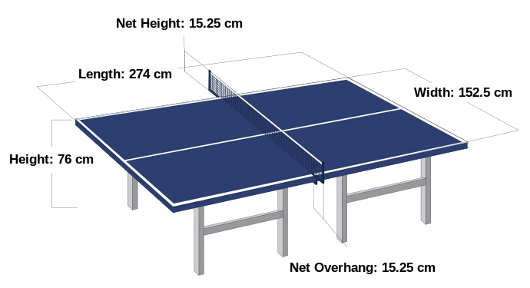
The sizes of table 274 cm length ,and 152.5 cm width ,76 cm high, and the majority of the tables with a dark green with line on the edges .A line divides the table halves lengthwise. The table divides the half line to the areas used by the players in doubles .Extending the network that rise between the existing display table in antsafha point and a network 15.25 cm high.

Slide 8
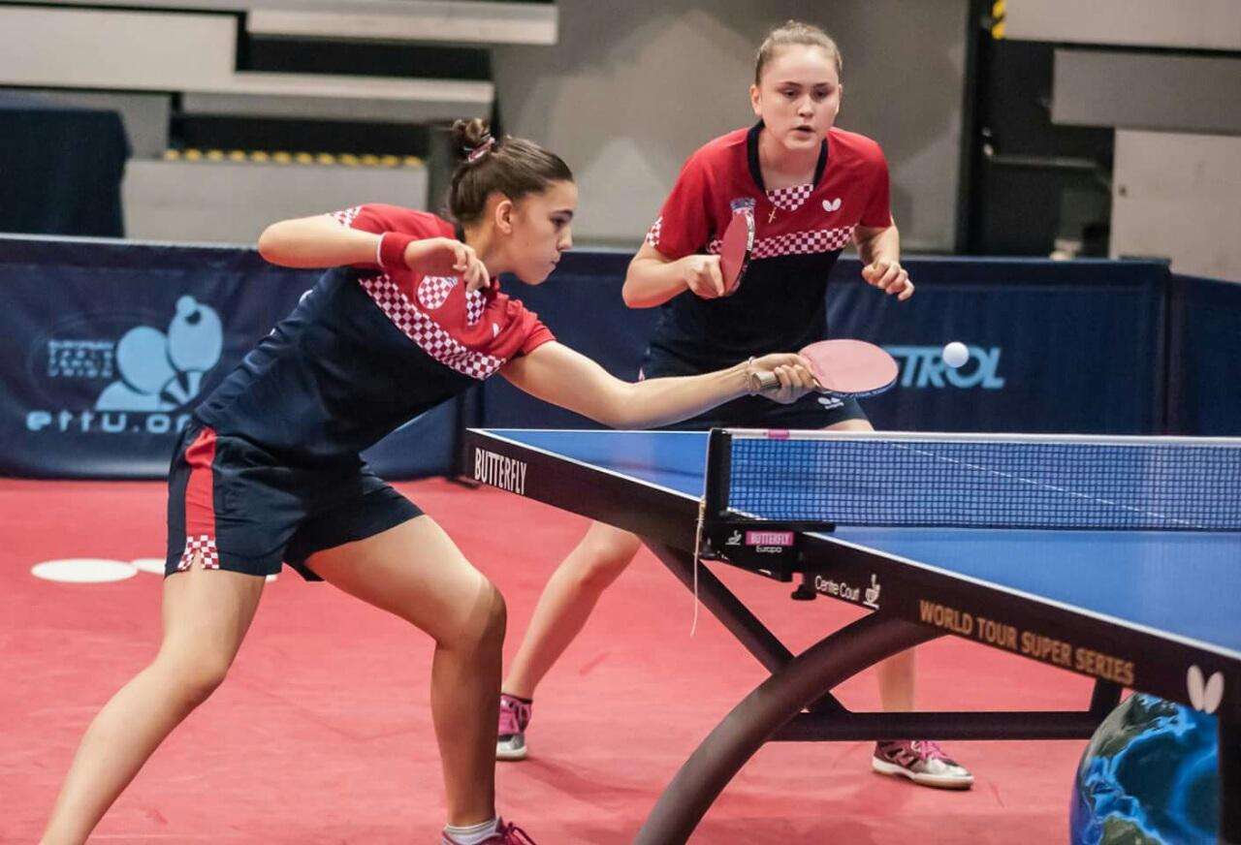
The game is Table tennis .In this picture there are tow players, One of them is standing defense through progress towards the table .She is extended arm around the table to cut the ball coming towards it , while the other arm is in case of lift near the shoulder to be the poise . Other player is worksing to prepare and standing near her player to cover the area and carrying out the attack and score points.

