Slide 1
Tenth Lecture

Slide 2
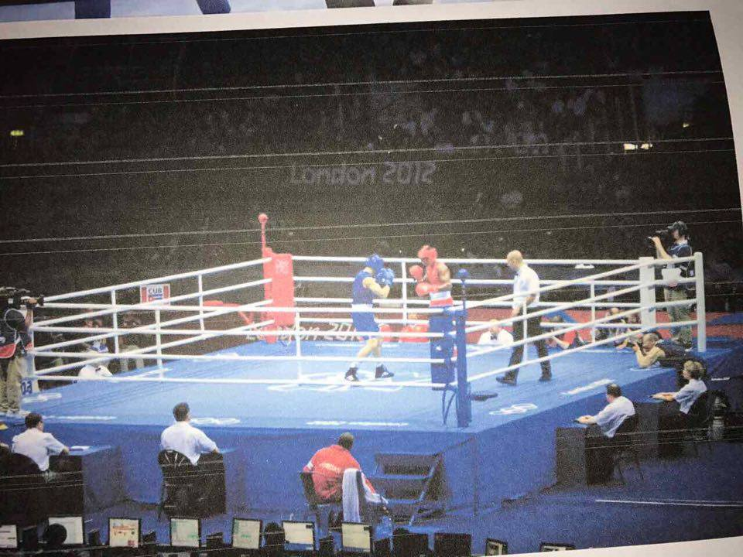
boxing
referee
boxer
ropes of the ring
النص هنا
corner
canvas
Corner pad
Corner posts
Seconds out assistants
Medical officer
Judging jury

Slide 3
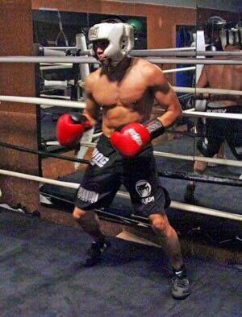
Parts of bod
Equipment of Boxing
Chest
Head protector
Gum protector
Heart
waist
Boxing Gloves
belly
Short and shoes
stomach
knee
shin

Slide 4
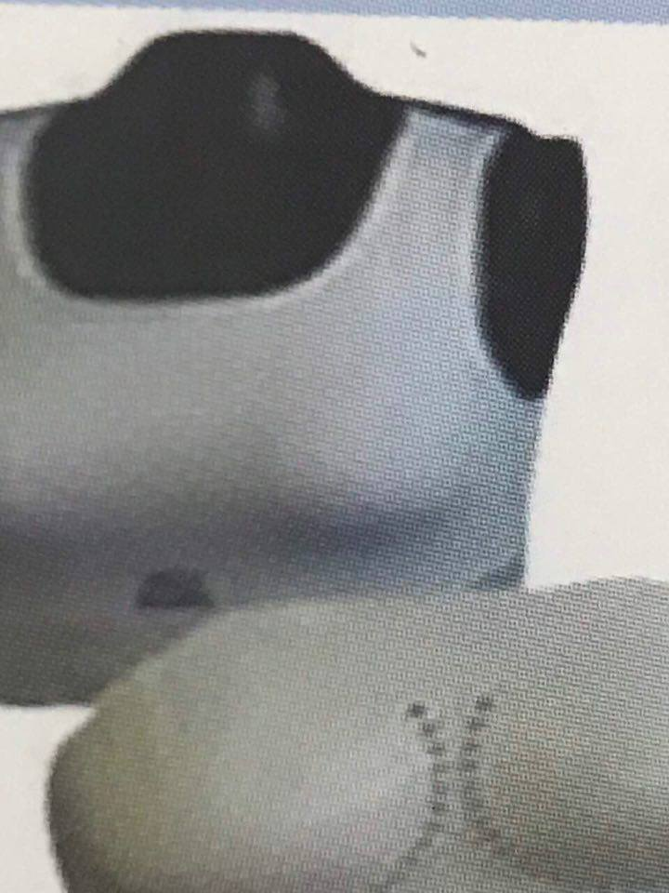
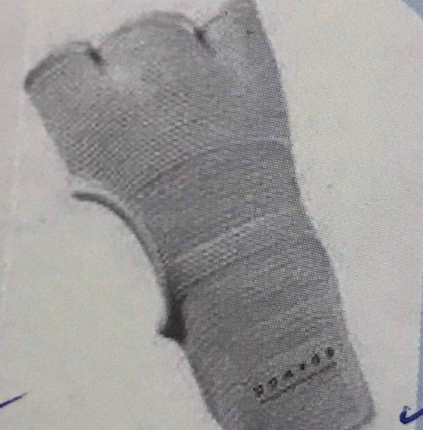
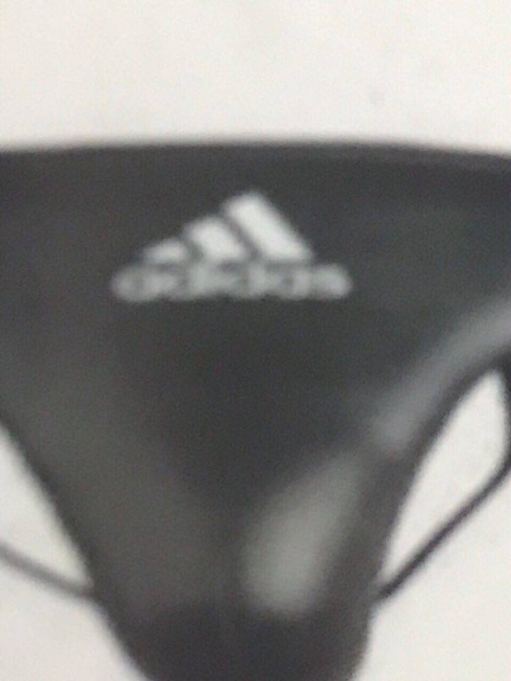
Equipment of boxing
Chest protector
band
Cup protector

Slide 5
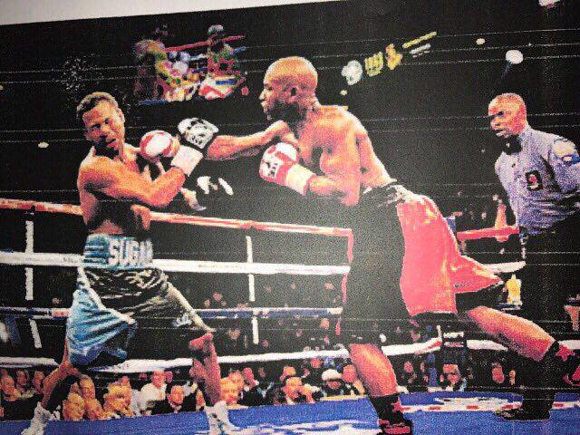
This game is called boxing.
The players are called boxer and play this game on a boxing field called the ring. In this picture there are tow players with one referee. We can also see many people. The first player is wearing a red short with red gloves in his hand and black shoes . He is standing on his left leg , the other right foot is flexed back . The other player is wearing a blue and black short with black gloves in his hand and white shoes . He is standing on his both legs, opening his tow legs to balance him self in order not to fell. The player with the red short is trying to attack the other player with his right hand while the other player is trying to turn his face in order to avoid the hit. He is trying to get points in order to with the match.

